Slide 1
EDA on automobile dataset
R.Kedarnath
For Insaid Term1 & Term 2 EDA project

Slide 2
Project introduction
The reason for choosing this dataset is that it has a close relation to the current scenario, where there is a decline in automobile industry
To see whether there are any factors that can have an impact on automobile sector.
Though the dataset given is not directly relevant to the current scenario, this is a study to understand the factors that can probably identify and help in further actions.

Slide 3
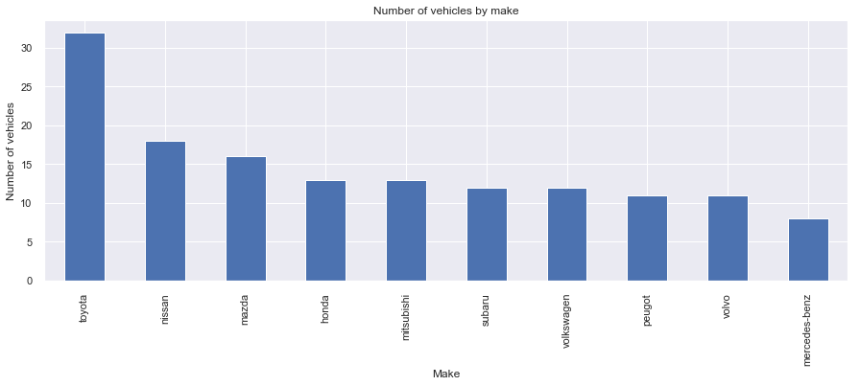
Data analysis (1/4)
Toyota is the make of the car which has most number of vehicles with more than 40% than the 2nd highest Nissan

Slide 4
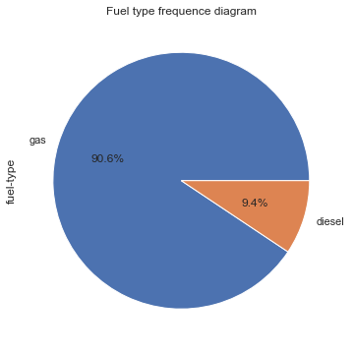
Data analysis (2/4)
From the plot it is very much evident, that the gas fuel type is the most preferred, contributing ~91% of the total.

Slide 5
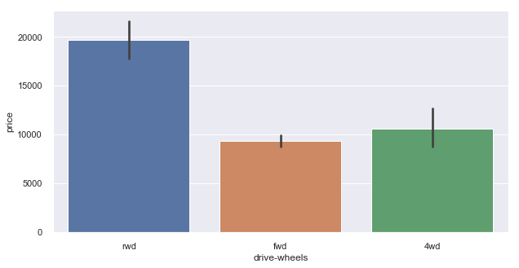
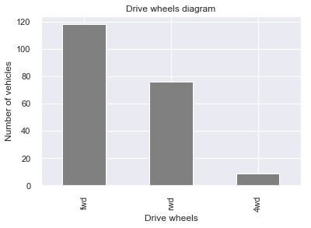
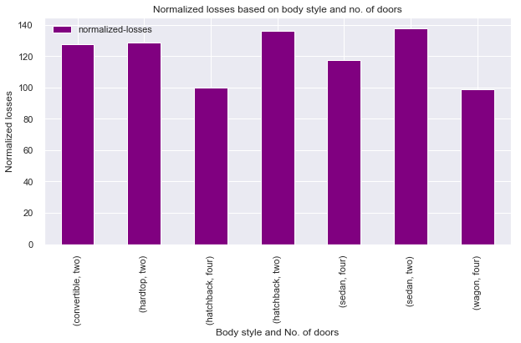
Data analysis (3/4)
It's very evident that the RWD cars are most expensive and FWD is least expensive cars
FWD vehicles are more in number
Normalized losses are distributed across different body style but the two door cars has more number of losses than the four door cars

Slide 6
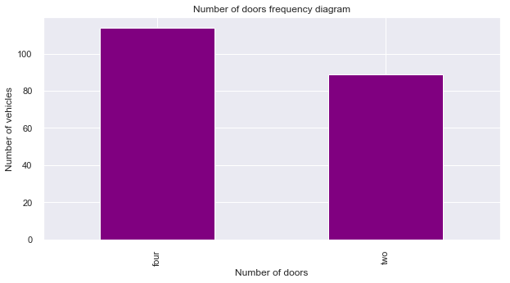
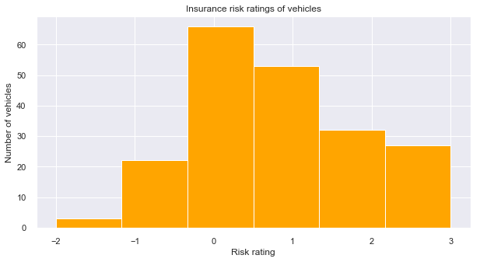
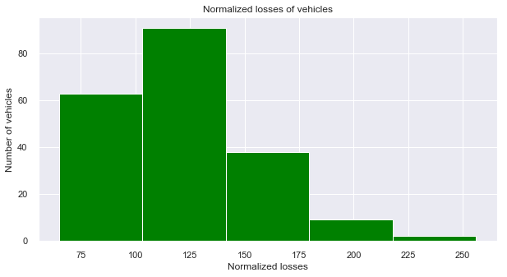
Data analysis (4/4)
Relation between number of doors, insurance, and normalized losses
Normalized loss is the average loss payment per insured vehicle. It is calculated by many features of the cars which includes body style and number of doors.
Normalized losses are distributed across different body style but the two door cars has more number of losses than the four door cars.

Slide 7
Summary
1. Gas vehicles are more preferred than the diesel vehicles. This seems to be a major correlation in current scenario, where there is uncertainty of Diesel in the BS6 era
2. From the study it is clear that the dataset is pretty old and not major causes can be cited for the current industry decline
Action point:
We need to focus more on point 1, where there are already more means to bring in electric vehicle throughout the world. It is very evident that electric vehicles are going to rule the world, thereby overcoming the confusion around BS6 emission standards (atleast in India).

